Slide 1
UNIT I - JAVA FUNDAMENTALS
Java Data types
Class – Object
I / O Streams
File Handling concepts
Threads
Applets
Swing Framework
Reflection

Slide 2
Introduction to Java
Java is an,
Object-Oriented
Multi-threaded programming language developed by Sun Microsystems in 1995.
James Gosling is known as the father of Java.
It is designed to be,
Small
Simple &
Portable
Popularity of java is based on three key elements
Usage of applets
Powerful programming language constructs
Rich set of significant object classes

Slide 3
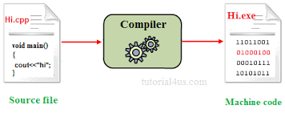
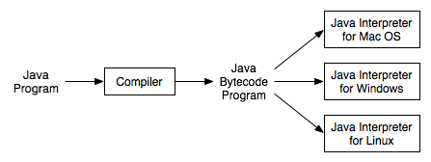
Introduction to Java
Normally,
Program compile→ We get Machine code
In java- 2 parts
Java Compiler
Generate bytecode (a set of instructions that resemble machine code but not specific to any processor)
2. Java Interpreter
Executes the java program

Slide 4
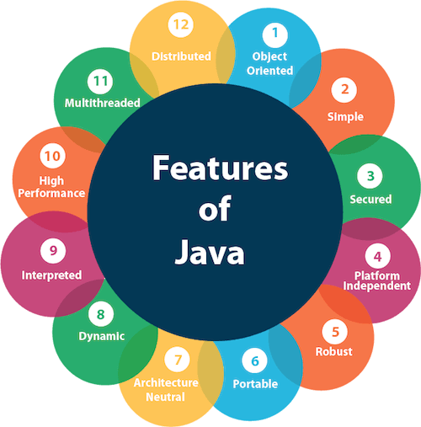
Features of Java

Slide 5
Features of Java
1. Object Oriented
In java, everything is an object which has some data and behavior
Java can be easily extended as it is based on Object Model
Following are some basic concept of OOP's.
Object
Class
Inheritance
Polymorphism
Abstraction
Encapsulation
2. Simple
Java is easy to learn and its syntax is quite simple, clean and easy to Java syntax is based on C++ (so easier for programmers to learn it after C++).
Java has removed many complicated and rarely-used features, for example, explicit pointers, operator overloading, etc.
There is no need to remove unreferenced objects because there is an Automatic Garbage Collection in Java.

Slide 6
Features of Java
3.Secured
Java is best known for its security.
With Java, we can develop virus-free and tamper free systems. Java is secured because:
No explicit pointer
Java program always runs in Java runtime environment with almost null interaction with system OS, hence it is more secure.
4. Platform Independent
Unlike other programming languages such as C, C++ etc which are compiled into platform specific machines. Java is guaranteed to be Write Once and Run Anywhere(WORA).
On compilation Java program is compiled into bytecode. This bytecode is platform independent and can be run on any machine, plus this bytecode format also provide security. Any machine with Java Runtime Environment can run Java Programs.

Slide 7
Features of Java
5.Robust
Robust simply means strong. Java is robust because:
It uses strong memory management.
There is a lack of pointers that avoids security problems.
There is automatic garbage collection in java which runs on the Java Virtual Machine to get rid of objects which are not being used by a Java application anymore.
There are exception handling and the type checking mechanism in Java. All these points make Java robust.
6.Portable
Java Byte code can be carried to any platform.
No implementation dependent features. Everything related to storage is predefined, example: size of primitive data types

Slide 8
Features of Java
7. Architectural Neutral
Compiler generates bytecodes, which have nothing to do with a particular computer architecture, hence a Java program is easy to interpret on any machine.
Java is architecture neutral because there are no implementation dependent features, for example, the size of primitive types is fixed.
In C programming, int data type occupies 2 bytes of memory for 32-bit architecture and 4 bytes of memory for 64-bit architecture. However, it occupies 4 bytes of memory for both 32 and 64-bit architectures in Java.
8.Dynamic
Java is a dynamic language. It supports dynamic loading of classes. It means classes are loaded on demand.
It also supports functions from its native languages, i.e., C and C++.
Java supports dynamic compilation and automatic memory management (garbage collection).

Slide 9
Features of Java
9.Interpreted
Java byte code is translated on the fly to native machine instructions and is not stored anywhere.
The development process is more rapid and analytical since the linking is an incremental and light-weight process.
10.High-performance
Java is faster than other traditional interpreted programming languages because Java bytecode is "close" to native code.
It is still a little bit slower than a compiled language (e.g., C++).
Java is an interpreted language that is why it is slower than compiled languages, e.g., C, C++, etc.

Slide 10
Features of Java
11.Multi-threaded
A thread is like a separate program, executing concurrently.
Java multithreading feature makes it possible to write program that can do many tasks simultaneously.
Benefit of multithreading is that it utilizes same memory and other resources to execute multiple threads at the same time, like While typing, grammatical errors are checked along.
Threads are important for multi-media, Web applications, etc.
12.Distributed
Java is also a distributed language
Programs can be designed to run on computer networks
Java has a special class library for communicating using TCP/IP protocols
Creating network connections is very much easy in Java as compared to C/C++.

Slide 11
To write java program
1.An Editor
2. A java compiler
3.Java Runtime Environment
The editor can be Notepad, WordPad, MS-DOS editor
To get 2 and 3 easiest way to get is to download Java Development Kit (JDK)

Slide 12
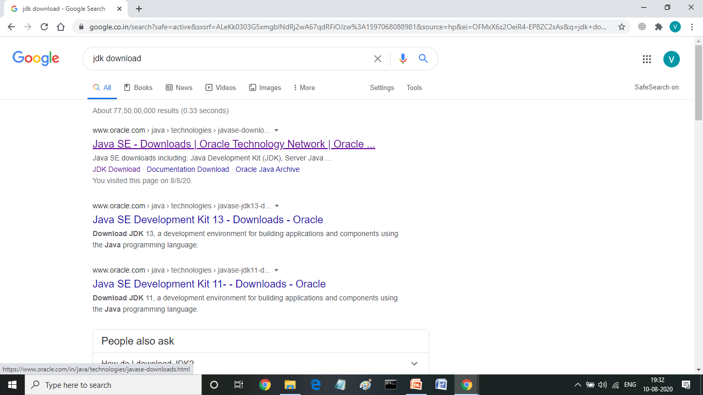
How to get JDK?
In a browser type jdk download and choose oracle.com
(or) go to the following URL
https://www.oracle.com/in/java/technologies/javase-downloads.html

Slide 13
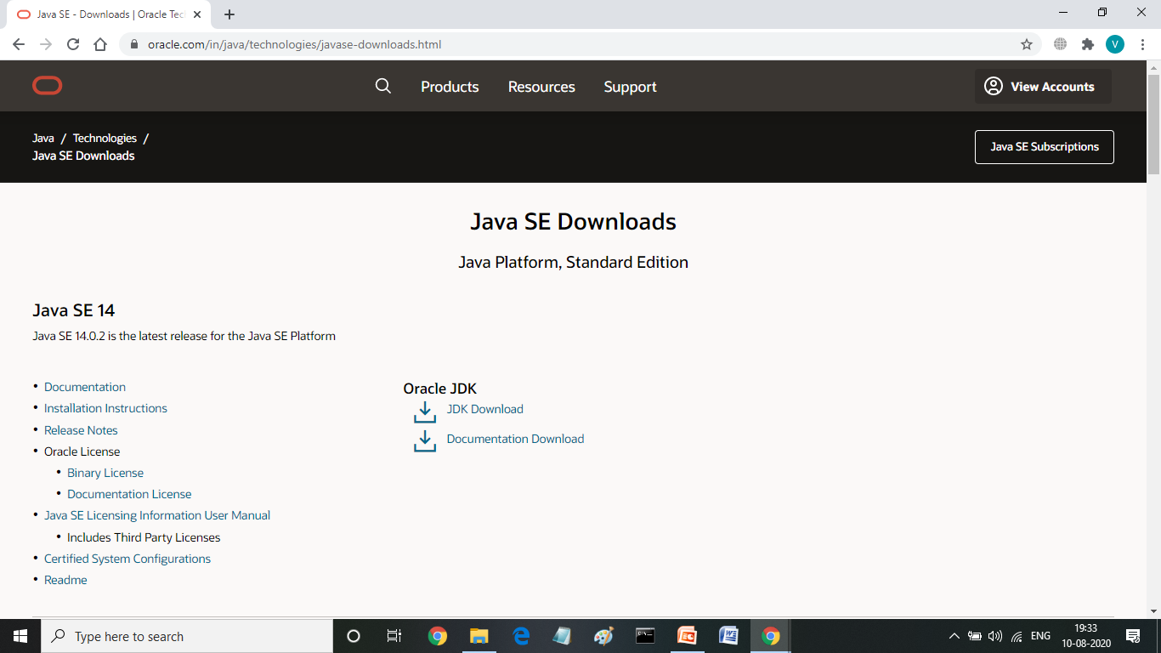
2.Click, JDK Download

Slide 14
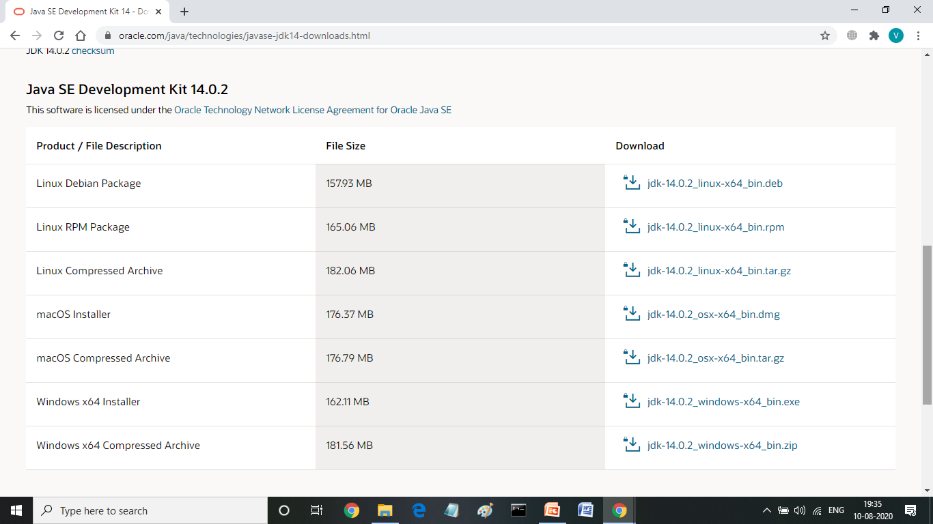
3. Choose a downloadable file based upon your OS

Slide 15
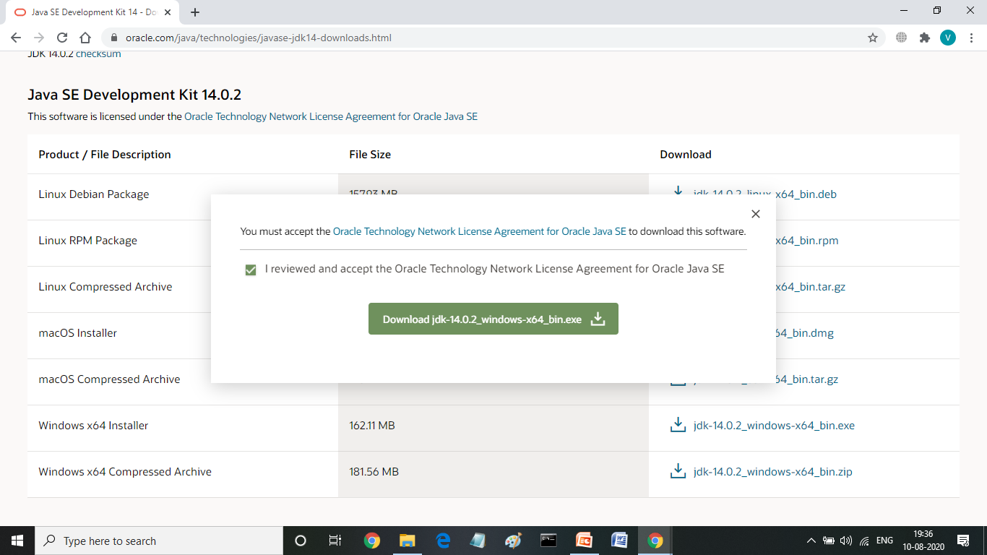
4.Click the checkbox and download

Slide 16
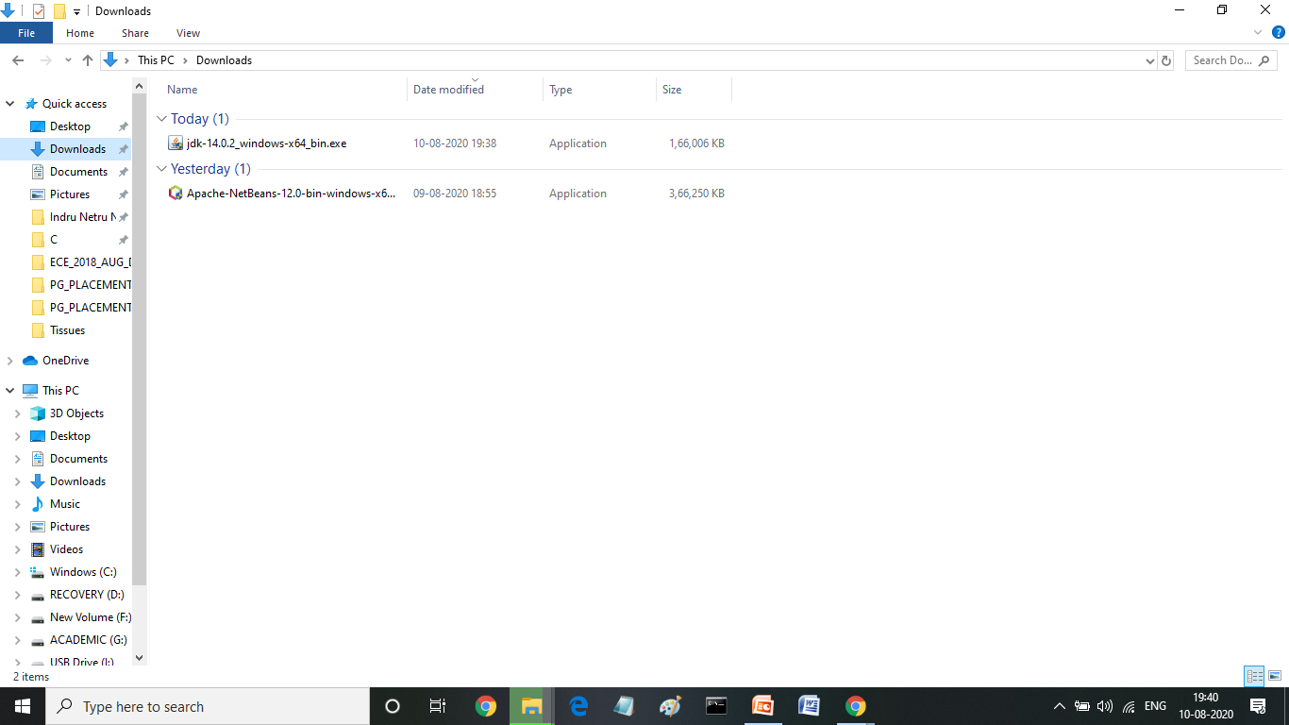
5.Click the .exe file downloaded in your downloads

Slide 17
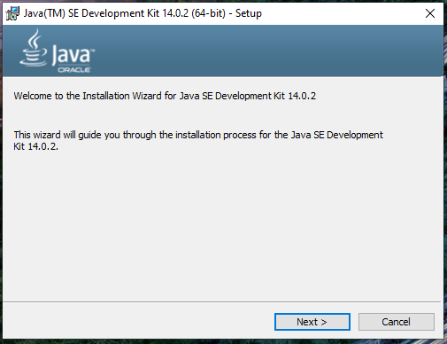
6.Just click the next button

Slide 18
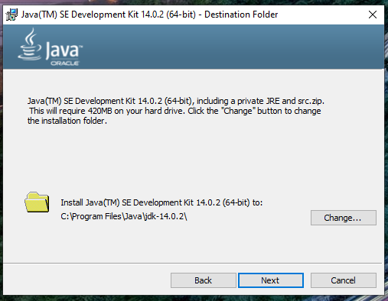
7.No need to change the path, just click next button

Slide 19
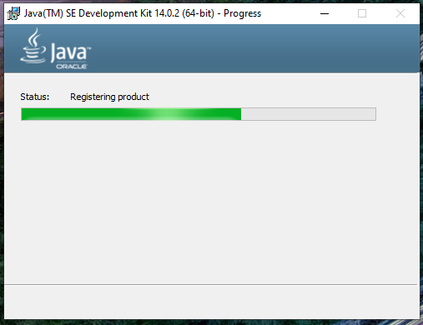
8.Wait for some time, it will take time…

Slide 20
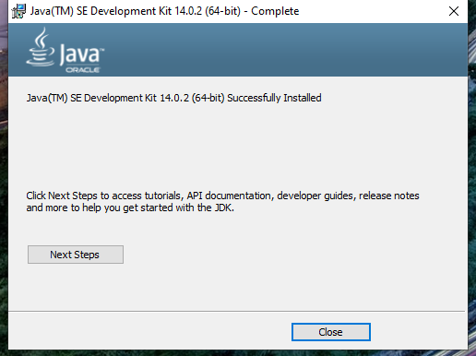
9.Once Installation is completed, click close button

Slide 21
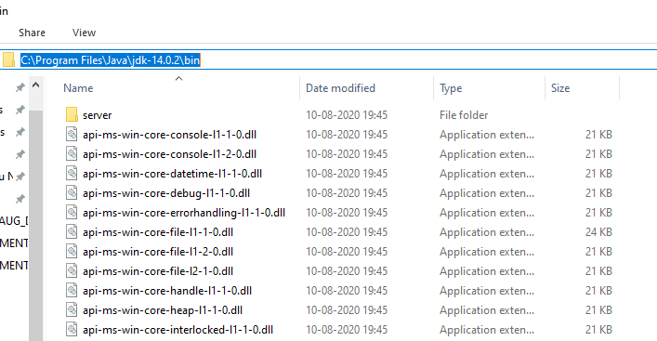
How to set path?
1.First copy the exact path where actually your jdk is installed

Slide 22
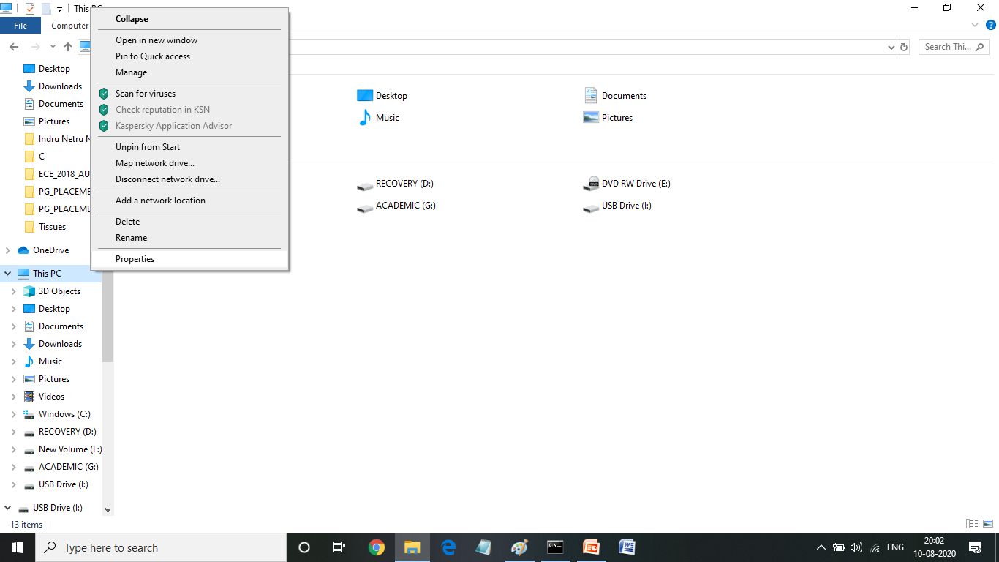
2.In my Computer right click to see the properties,

Slide 23
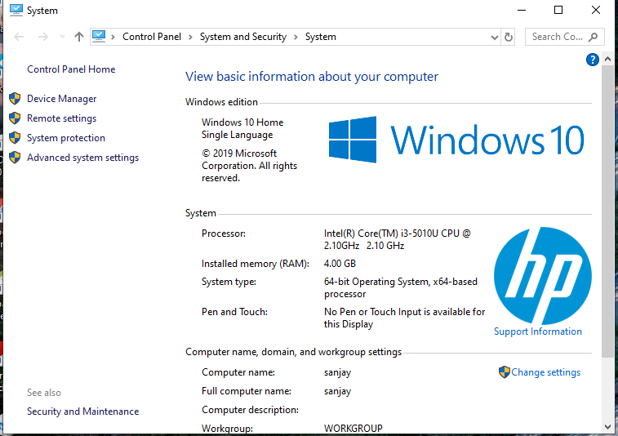
3.Click Advanced System settings

Slide 24
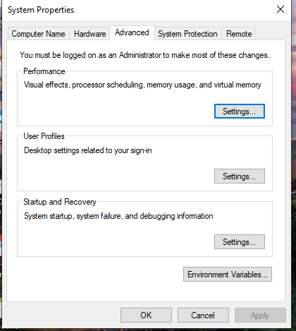
4.Click Environment Variables

Slide 25
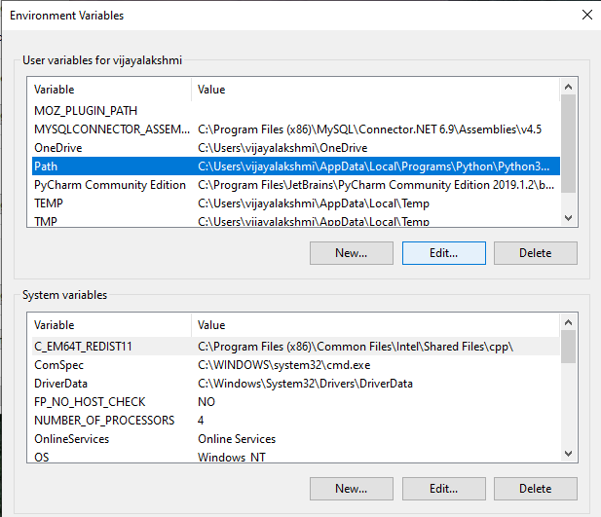
5. Select Path and press Edit Button

Slide 26
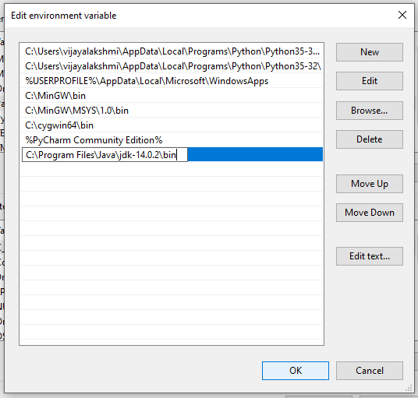
6.Click New button, and past the path of your jdk bin and press OK

Slide 27
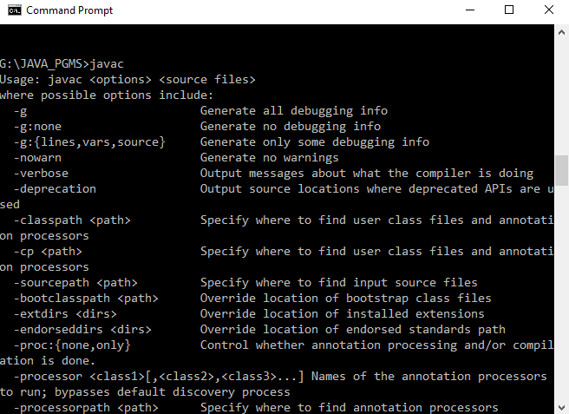
To Check JDK installed properly
Open a command prompt and type, javac

Slide 28
C++ vs JAVA Program
C++ Program
#include<iostream.h>
void main()
{
cout<<"Welcome to Web Tech class";
}
JAVA Program
class Welcome
{
public static void main(String args[])
{
System.out.println("Welcome to Web Tech class");
}
}

Slide 29
Parameters used in First Java Program
Lets understand what our first java program consists of and its keypoints,
class : class keyword is used to declare classes in Java
public : It is an access specifier. Public means this function is visible to all.
static : static is again a keyword used to make a function static. To execute a static function you do not have to create an Object of the class. The main() method here is called by JVM, without creating any object for class.
void : It is the return type, meaning this function will not return anything.
main : main() method is the most important method in a Java program. This is the method which is executed, hence all the logic must be inside the main() method. If a java class is not having a main() method, it causes compilation error.
String[] args : This represents an array whose type is String and name is args and is used for command line argument. We will discuss more about array in Java Array section.
System.out.println : This is used to print anything on the console like printf in C language. Here, System is a class, out is the object of PrintStream class, println() is the method of PrintStream class. We will learn about the internal working of System.out.println statement later.

Slide 30
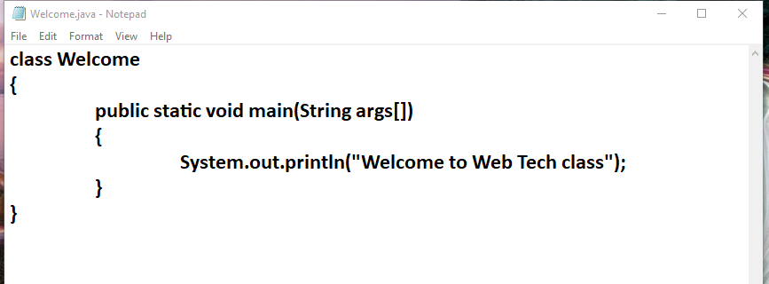
How to write a java code and execute it?
1.Open a notepad and type the java code
2.Save the file with the name of the class file and with .java extension, ex Welcome.java

Slide 31
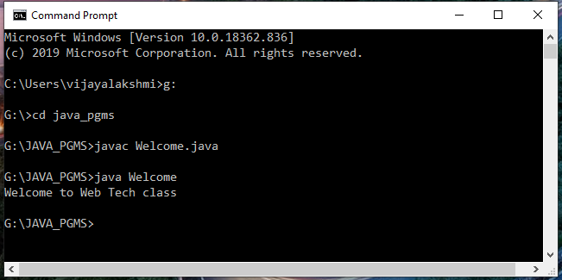
How to write a java code and execute it?
3. Open command prompt and go to the directory where you saved your first java program.
4. Type javac Welcome.java and press Return(Enter KEY) to compile your code. This command will call the Java Compiler asking it to compile the specified file. If there are no errors in the code the command prompt will take you to the next line.
5. Now type java Welcome on command prompt to run your program.
6. You will be able to see Welcome to Web Tech class printed on your command prompt.

